Slide 1
Evolution of Management
Sayantan Mukherjee
VITBS, VIT Bhopal

Slide 2
CONTENT
Evolution of Management: Taylor and Scientific Management, Fayol’s Administrative Management, Bureaucracy, Hawthorne Experiments and Human Relations, Social System Approach, Decision Theory Approach

Slide 3
Evolution of Management Concept
The evolution of management thought is a process that started in the early days of man.
It began since the period man saw the need to live in groups.
Mighty men were able to organize the masses, share them into various groups.
The sharing was done accord to the masses’ strength, mental capacities, and intelligence.
The point is that management has been practiced in one way or the other since civilization began.
If you want a good example where advance management principles where applied, consider the organization of the olden days Roman Catholic Church, military forces as well as ancient Greece. These are all excellent examples.
But the industrial revolution brought drastic change.
And suddenly, the need to develop a more holistic and formal management theory became a necessity.

Slide 4
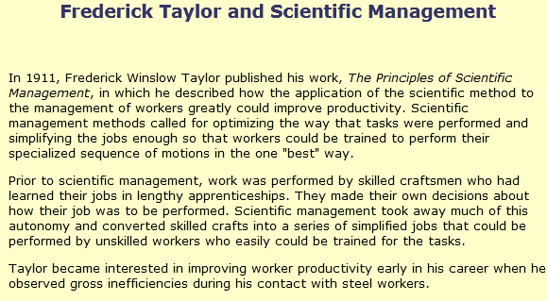
Scientific Management

Slide 5
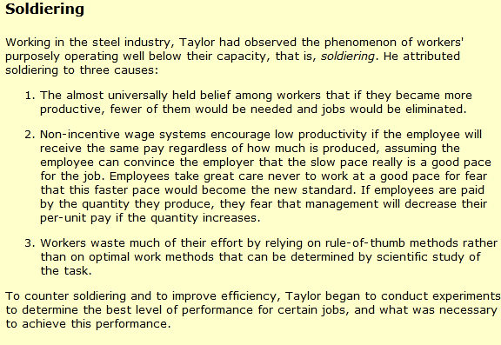
Soldiering

Slide 6
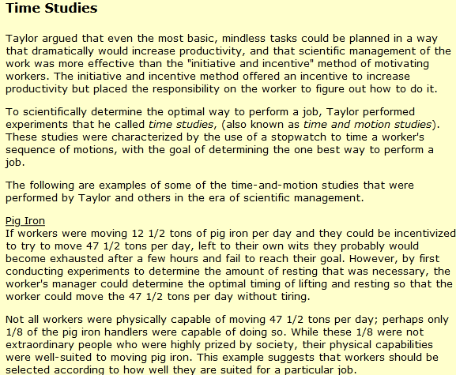

Slide 7
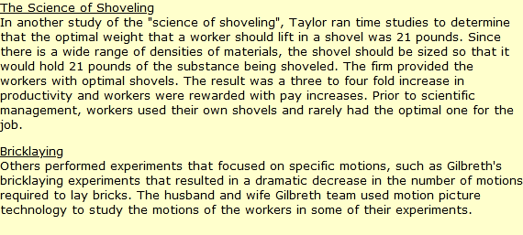

Slide 8
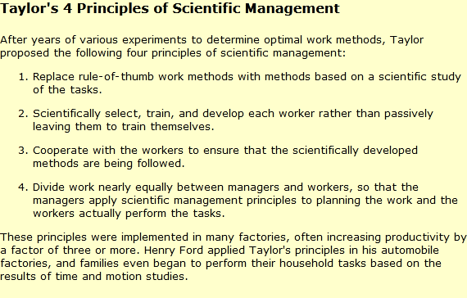

Slide 9
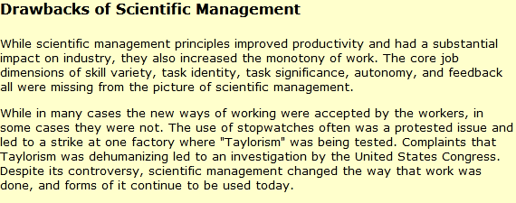

Slide 10
Fayol’s Administrative Management
Definition:
The Administrative Theory is based on the concept of departmentalization, which means the different activities to be performed for achieving the common purpose of the organization should be identified and be classified into different groups or departments, such that the task can be accomplished effectively.
The administrative theory is given by Henri Fayol, who believed that more emphasis should be laid on organizational management and the human and behavioral factors in the management.
Thus, unlike the scientific management theory of Taylor where more emphasis was on improving the worker’s efficiency and minimizing the task time
here the main focus is on how the management of the organization is structured and how well the individuals therein are organized to accomplish the tasks given to them.

Slide 11
The other difference between these two is, the administrative theory focuses on improving the efficiency of management first so that the processes can be standardized and then moves to the operational level where the individual workers are made to learn the changes and implement those in their routine jobs.
While in the case of the scientific management theory, it emphasizes on improving the efficiency of the workers at the operating level first which in turn improves the efficiency of the management. Thus, the administrative theory follows the top-down approach while the scientific management theory follows the bottom-up approach.
Fayol has given 14 principles of management with the intent to improve the functioning of the managers.

Slide 12
The Bureaucratic Model
A German Sociologist called Max Weber proposed this model. And it includes a system of rules, division of labor hinged on functional specialization, legal authority, and power, the hierarchy of authority and placement of employees based on their technical competence.
Max Weber bureaucracy ideally has the following characteristics:
Specialization of labor
A formal set of rules and regulations
Well-defined hierarchy within the organization
Impersonality in the application of rules

Slide 13
Max Weber listed six major principles of the bureaucratic form as follows:
A formal hierarchical structure – In a bureaucratic organization, each level controls the level below it. Also, the level above it controls it. A formal hierarchy is the basis of central planning and centralized decision-making.
Rules-based Management – The organization uses rules to exert control. Therefore, the lower levels seamlessly execute the decisions made at higher levels.
Functional Specialty organization – Specialists do the work. Also, the organization divides employees into units based on the type of work they do or the skills they possess.
Up-focused or In-focused Mission – If the mission of the organization is to serve the stockholders, board, or any other agency that empowered it, then it is up-focused. On the other hand, if the mission is to serve the organization itself and those within it (like generating profits, etc.), then it is in-focused.
Impersonal – Bureaucratic organizations treat all employees equally. They also treat all customers equally and do not allow individual differences to influence them.
Employment-based on Technical Qualifications – Selection as well as the promotion of employees is based on technical qualifications and skills.

Slide 14
Hawthorne Experiments and Human Relations
Professor George Elton Mayo (1880-1949) has secured fame as the leader in a series of experiments which became one of the great turning-points in management thinking.
At the Hawthorne plant of Western Electric, he discovered that job satisfaction increased through employee participation in decisions rather than through short-term incentives.
Mayo's importance to management lies in the fact that he established evidence on the value of a management approach and style which, although not necessarily an alternative to F W Taylor's scientific management, presented facts which Taylorites could not ignore.

Slide 15
Key theories
Hawthorne
The Hawthorne plant of Western Electric was located in Chicago. It had some 29,000 employees and manufactured telephones and telephone equipment, principally for AT & T. The company had a reputation for advanced personnel policies and had welcomed a research study by the National Research Council into the relationship between work-place lighting and individual efficiency.
The experiments
The study began in 1924 by isolating two groups of workers in order to experiment with the impact of various incentives on their productivity. Improvements to levels of lighting produced increases in productivity, but so too did reversion to standard lighting and even below-standard lighting in both groups. The initial assumption therefore was that increased output stemmed from variation alone.
Other incentives - including payment incentives and rest pauses - were manipulated at regular intervals, and although output levels varied, the trend was inexorably upwards. Whatever experimentation was applied, output went up. Although it had been fairly conclusively determined that lighting had little or nothing to do with output levels, the Assistant Works Manager (George Pennock) agreed that something peculiar was going on and that experimentation should continue.

Slide 16
Interpreting Hawthorne
For industry to benefit from the experiments at Hawthorne, Mayo first concluded that supervisors needed training in understanding the personal problems of workers, and also in listening and interviewing techniques. He held that the new supervisor should be less aloof, more people-oriented, more concerned, and skilled in handling personal and social situations.
It was only later, after a period of reflection, that Mayo was able to conclude that:
job satisfaction increased as workers were given more freedom to determine the conditions of their working environment and to set their own standards of output;
intensified interaction and cooperation created a high level of group cohesion;
job satisfaction and output depended more on cooperation and a feeling of worth than on physical working conditions.
In Mayo's view, workers had been unable to find satisfactory outlets for expressing personal problems and dissatisfactions in their work life. The problem, as Mayo perceived it, was that managers thought the answers to industrial problems resided in technical efficiency, when actually the answer was a human and social one.

Slide 17
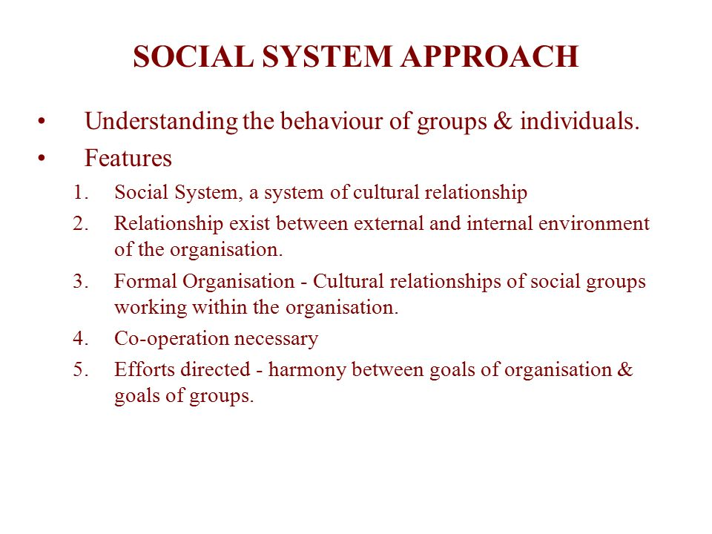

Slide 18
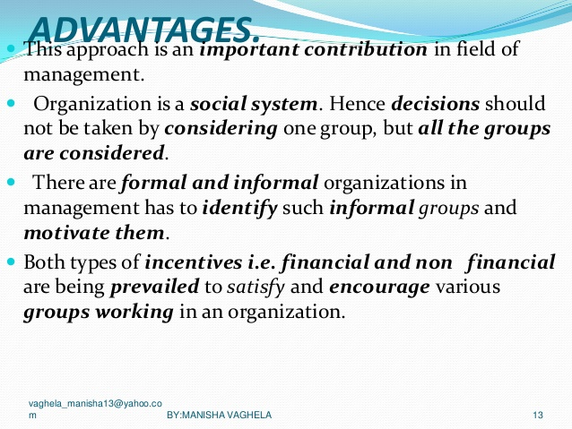

Slide 19
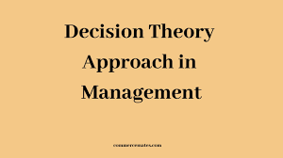
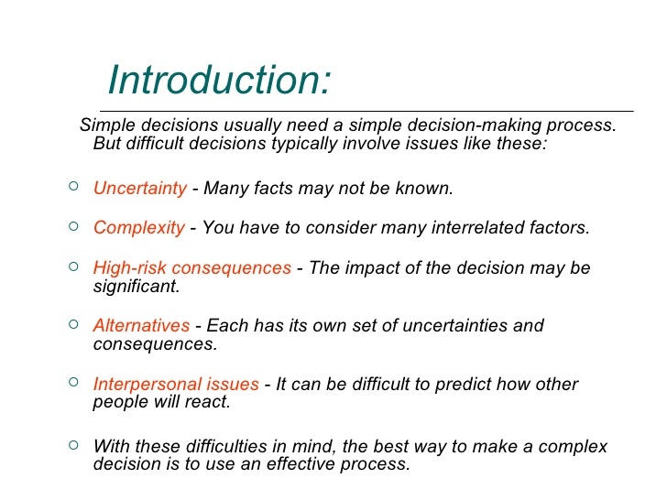

Slide 20
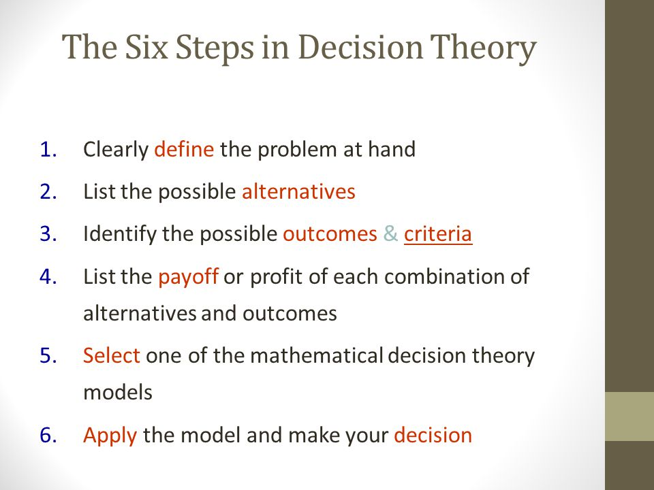

Slide 21


